Slide 1
Blocked
Final-Goal Calibration Presentation
unoptimized: Abraham George | Amirpouya Hemmasian | Charlotte Avra | Connor Geshan | Yayati Jadhav

Slide 2
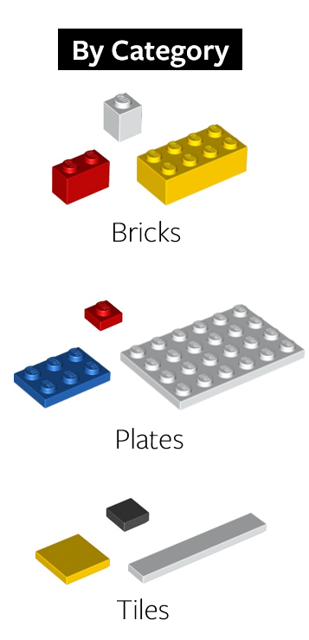
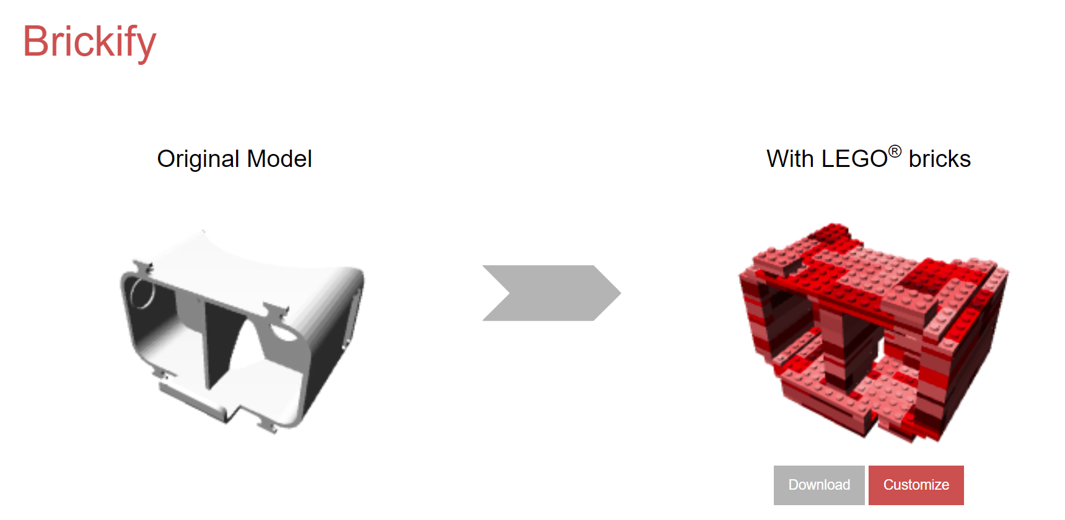
Review: Program Overview
Program inputs an STL file and simplifies it into smaller block units
Simplest = Use single block type
More complex = User can choose which types of blocks to use
Source: brickify.it
Outputs BOM (bill of materials) with block type and quantity of each required
Shows layerwise steps for laying bricks (implement slider bar)
User interface
Notes:
BOM : Bill of material

Slide 3
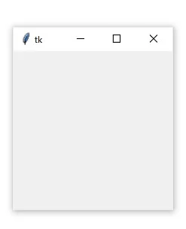
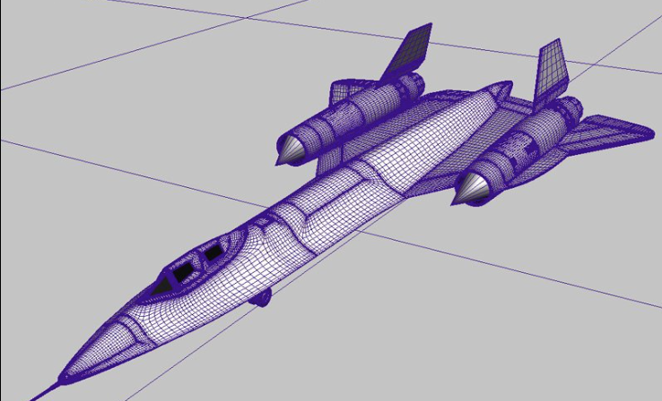
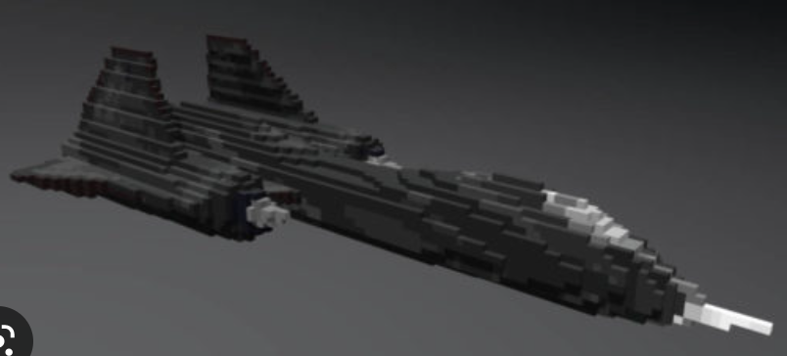
Review: Program Outline
Combine FsSimpleWindow with a standard GUI Library
Voxelize STL file
Stability analysis post voxelization
Iterate:
Recompilation of voxelized parts into a single structure
Generation of cost function to optimize block selection and assembly/stackability
Selection of block type to minimize overall fabrication cost
User Interface
Input STL File
Output Block Model

Slide 4

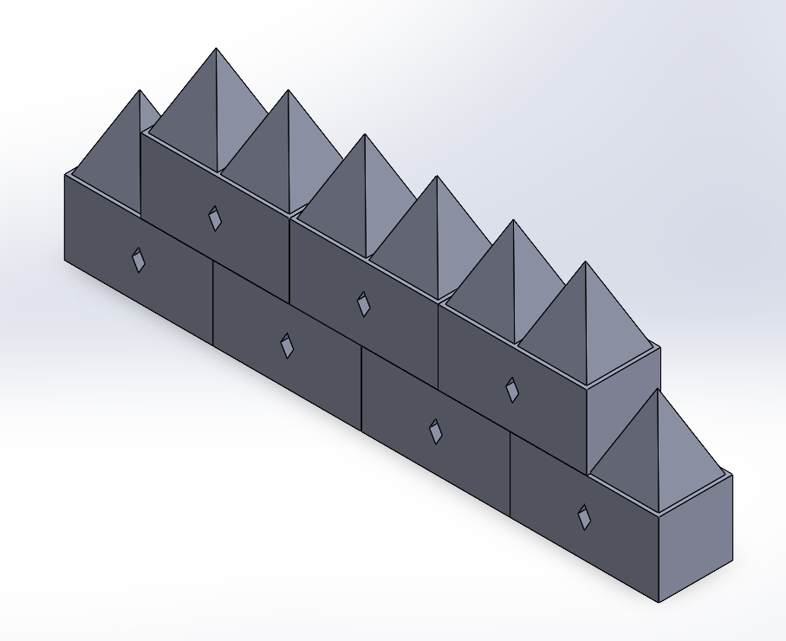
Review: Topic Significance
Engineering Motivation: Drone additive manufacturing
Inspired by a lab project: using CrazyFlie drones to assemble structures
Use 3D printed blocks as building material.
To simplify construction, speed up printing, and increase interchangeability, we only want to use a few block types but the number/shapes of these is flexible.
Requires conversion of STL file → instructions for building it using blocks
Similar role to a 3D printer slicer program
Can be used for building any structure out of smaller units
Reduce prototyping time
3D printing takes too long to make a prototype
A software that can give block based plan would make initial prototyping significantly faster
CrazyFlie Drone
Block Design for CrazyFlie Project

Slide 5
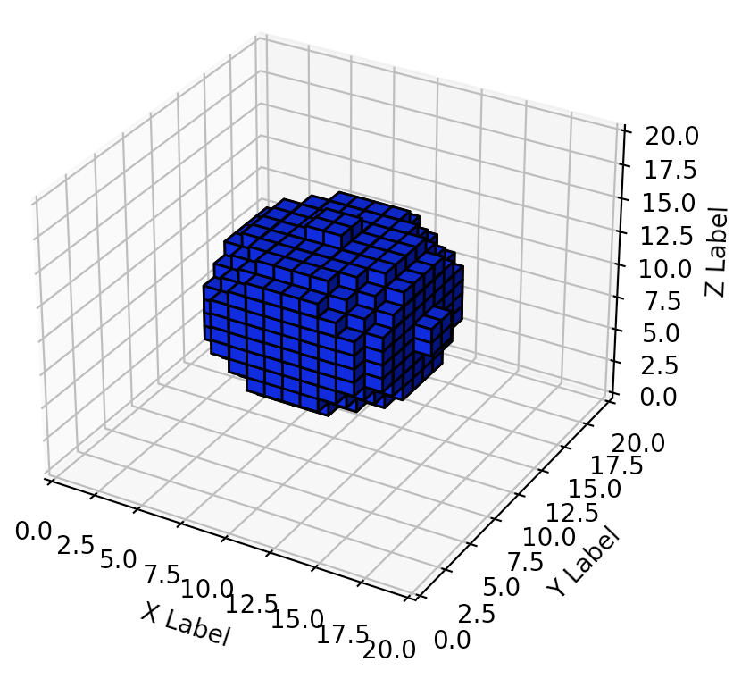
Current Progress
Voxelization
Surface voxelization currently works for symmetric watertight mesh with no holes
Merging
Passed first unit test - merging a very simple design.
Found a merged design that was stable and had the minimum possible cost
But, only works for a limited number of block shapes and the optimization isn’t robust.
STL Voxelization

Slide 6
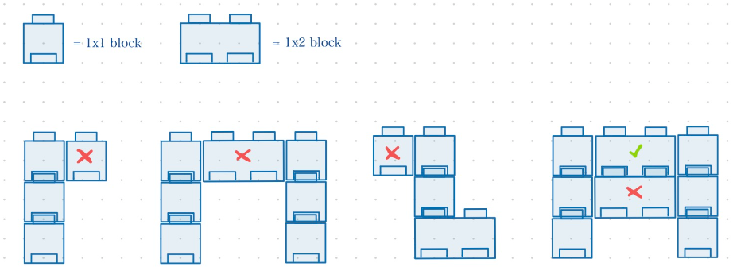
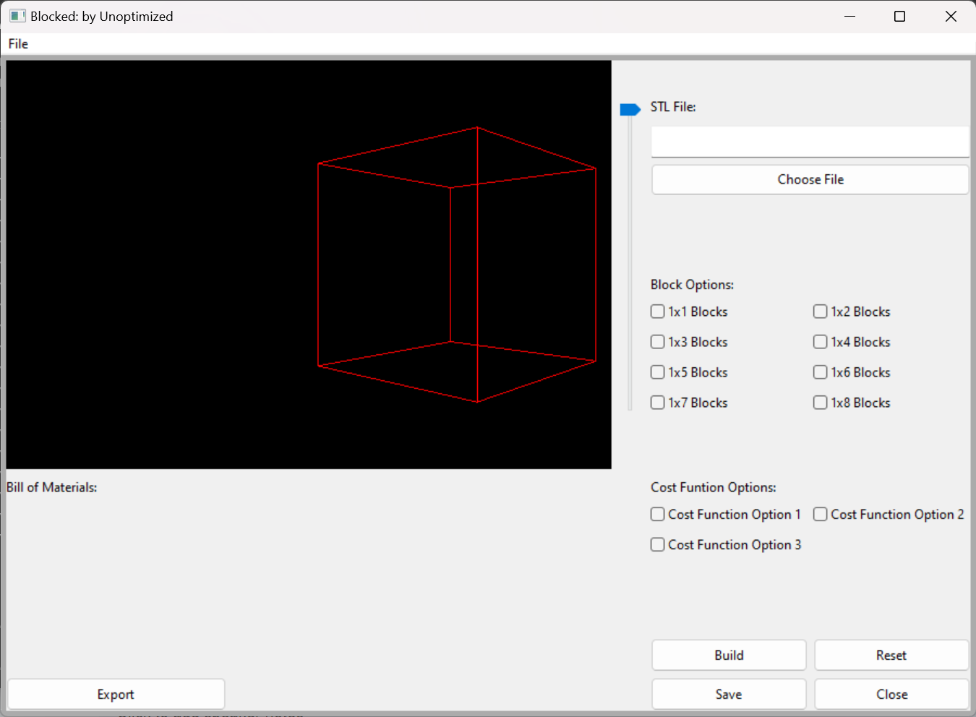
Current Progress
Stability Analysis
Defined pass/fail test for final model stability
Currently only checks to ensure model is buildable
Used by Merge function to optimize merged model
GUI
Passed first unit test - cross platform building
Successfully access OS file manager
Import STL file
Take all widget input (key for passing arguments to functions)
Cost Function
Implemented a crude version
Came up with locality graph and connectivity graph idea
Visualization of Stability Check
Current GUI

Slide 7
Goals
Voxelization
Make voxelization more robust and add flood fill
Merging
Must be able to find the ideal assembly of blocks that is stable and minimizes the cost function
Must work for a wide range of block types
Should robustly optimize cost function, without becoming too expensive at large scale
Search with limited depth (similar to MPC)
Stability Analysis
Address additional stability and buildability cases
GUI
Must be able to render imported STL
Render 3d model post conversion
Implement slider functionality to only display certain portions of blocked model
Populate Bill of Materials and allow user to export BOM as a .txt file (preferably csv)
Cost Function
Address computational cost, add graph connectivity calculations

Slide 8
Product Calibration
Removing From Final Version | Reason
Present to the user a structural analysis of multiple different possible assemblies | Focus on stability and cost functions rather than structural integrity of the final model, and simplify GUI - don’t want to show multiple options
Unlimited user-defined options for different block types | Limiting the options for block types eliminates edge cases and simplifies the GUI.

